Slide 1
Cowboy pride
* Be kind * be safe * be responsible * be ready to learn *

Slide 2
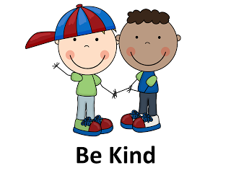
Be kind
Hallways/ Walkways | Cafeteria | Restroom | Classroom | Playground
Say “good morning, excuse me, thank you.” | Wait for your turn in line. Say, “please” and “thank you.” | Give students privacy in the restroom. Knock on the door before entering. Flush the toilet. | Take turns. Follow directions. Listen to others that are speaking. Help a classmate if needed. | Taking turns; Kind words, include others in your play. Share play equipment.

Slide 3
Be safe
Hallways/ Walkways | Cafeteria | Restroom | Classroom | Playground
Walking in hall Staying on right side. Keep hands and feet to yourself. | Body parts to yourself. Use walking feet. | Report any spills on the floor. Don’t clog toilets. | Push in chairs, hang up your backpacks/ jackets. Clean up or tell an adult about spills in bathroom or sink area. | Keep your body parts to yourself Report unsafe behavior to an adult.

Slide 4
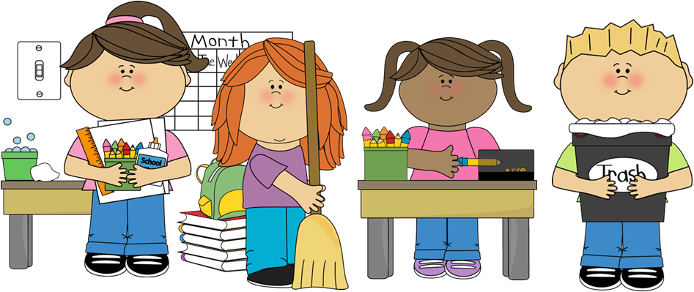
Be responsible
Hallways/ Walkways | Cafeteria | Restroom | Classroom | Playground
Stay with your buddy Go directly to your location. | Clean your space. Pick up any trash on the table and floor. | Use toilet, flush, wash your hands. Only put toilet tissue in the toilet. | Clean up supplies; turn in your work; keep your desk clean; complete classwork | Clean up any supplies (jackets, lunchboxes, sports equipment). Use equipment appropriately.

Slide 5
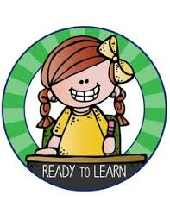
Be ready to learn
Hallways/ Walkways | Cafeteria | Restroom | Classroom | Playground
Go quickly to your location. Return quickly to your class Inside voices in halls. | Listen to all adults and directions. Be ready to line up when your teacher arrives. | Finish and return directly to class. Ask permission. | Eyes on teacher, in your spot, have your supplies ready; Focus on your task. | Follow directions from adults. Line up when called so you can return to learning.

Slide 6
March cowboy celebration
movie day!

Slide 7
How do I get a ticket?
If you are:
Kind
Safe
Responsible
Ready to learn
Less than 3 minor infractions in march
No office referrals in march
No cowboy cash needed to attend ☺

Slide 8
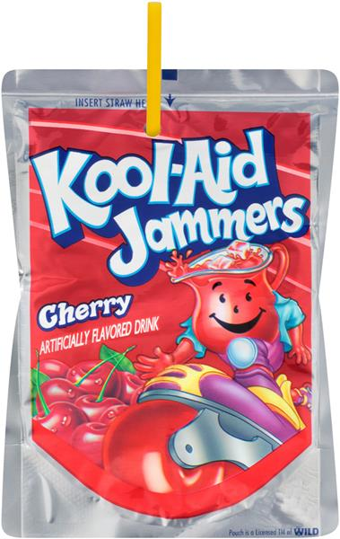
Get that cowboy cash… save it for movie day!
You will get to buy snacks
$5.00 for each item
*limit two items per student

Slide 9
Cowboy pride march celebration

